Slide 1
Module 2 – Syntax Analysis

Slide 2
Role of parser
Token
Parse tree
Source program
Lexical analyzer
Parse tree
Rest of front end
IR
Parser
Get next token
Symbol table
Parser obtains a string of token from the lexical analyzer and reports syntax error if any otherwise generates syntax tree.
There are two types of parser:
Top-down parser
Bottom-up parser

Slide 3
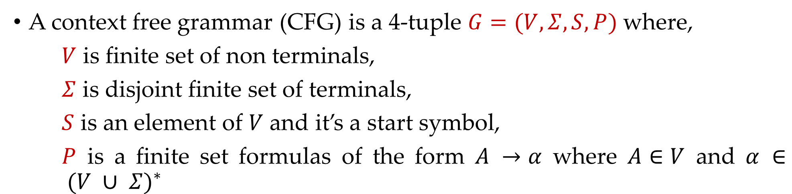
Context free grammar
A context free grammar (CFG) is a 4-tuple $G=(V,Σ,S,P)$where,
$V$ is finite set of non terminals,
$Σ$ is disjoint finite set of terminals,
$S$ is an element of $V$ and it’s a start symbol,
$P$ is a finite set formulas of the form $A →α$ where $A∈V$ and $α ∈ {(V ∪ Σ)}^{∗}$
Nonterminal symbol:
The name of syntax category of a language, e.g., noun, verb, etc.
The It is written as a single capital letter, or as a name enclosed between < … >, e.g., A or <Noun>
<Noun Phrase> → <Article><Noun>
<Article> → a | an | the
<Noun> → boy | apple

Slide 4

Context free grammar
A context free grammar (CFG) is a 4-tuple $G=(V,Σ,S,P)$where,
$V$ is finite set of non terminals,
$Σ$ is disjoint finite set of terminals,
$S$ is an element of $V$ and it’s a start symbol,
$P$ is a finite set formulas of the form $A →α$ where $A∈V$ and $α ∈ {(V ∪ Σ)}^{∗}$
Terminal symbol:
A symbol in the alphabet.
It is denoted by lower case letter and punctuation marks used in language.
<Noun Phrase> → <Article><Noun>
<Article> → a | an | the
<Noun> → boy | apple

Slide 5

Context free grammar
A context free grammar (CFG) is a 4-tuple $G=(V,Σ,S,P)$where,
$V$ is finite set of non terminals,
$Σ$ is disjoint finite set of terminals,
$S$ is an element of $V$ and it’s a start symbol,
$P$ is a finite set formulas of the form $A →α$ where $A∈V$ and $α ∈ {(V ∪ Σ)}^{∗}$
Start symbol:
First nonterminal symbol of the grammar is called start symbol.
<Noun Phrase> → <Article><Noun>
<Article> → a | an | the
<Noun> → boy | apple

Slide 6
Context free grammar
A context free grammar (CFG) is a 4-tuple $G=(V,Σ,S,P)$where,
$V$ is finite set of non terminals,
$Σ$ is disjoint finite set of terminals,
$S$ is an element of $V$ and it’s a start symbol,
$P$ is a finite set formulas of the form $A →α$ where $A∈V$ and $α ∈ {(V ∪ Σ)}^{∗}$
Production:
A production, also called a rewriting rule, is a rule of grammar. It has the form of
A nonterminal symbol → String of terminal and nonterminal symbols
<Noun Phrase> → <Article><Noun>
<Article> → a | an | the
<Noun> → boy | apple

Slide 7
stmt -> if ( expr ) stmt else stmt

Slide 8
Example: Grammar
Write terminals, non terminals, start symbol, and productions for following grammar.
E → E O E| (E) | -E | id
O → + | - | * | / | ↑
Terminals: id + - * / ↑ ( )
Non terminals: E, O
Start symbol: E
Productions: E → E O E| (E) | -E | id
O → + | - | * | / | ↑

Slide 9
Derivation & Ambiguity

Slide 10
Derivation
Derivation is used to find whether the string belongs to a given grammar or not.
Types of derivations are:
Leftmost derivation
Rightmost derivation

Slide 11
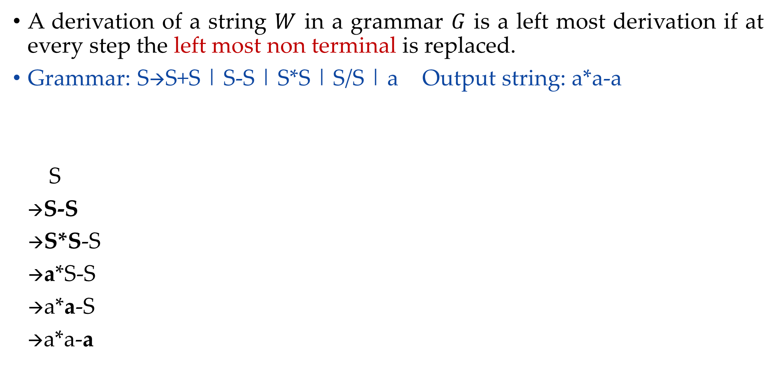
Leftmost derivation
A derivation of a string $W$ in a grammar $G$ is a left most derivation if at every step the left most non terminal is replaced.
Grammar: S→S+S | S-S | S*S | S/S | a Output string: a*a-a
S
→S-S
→S*S-S
→a*S-S
→a*a-S
→a*a-a
S
Parse tree represents the structure of derivation
S
-
S
S
*
S
a
a
a
Parse tree
Leftmost Derivation

Slide 12
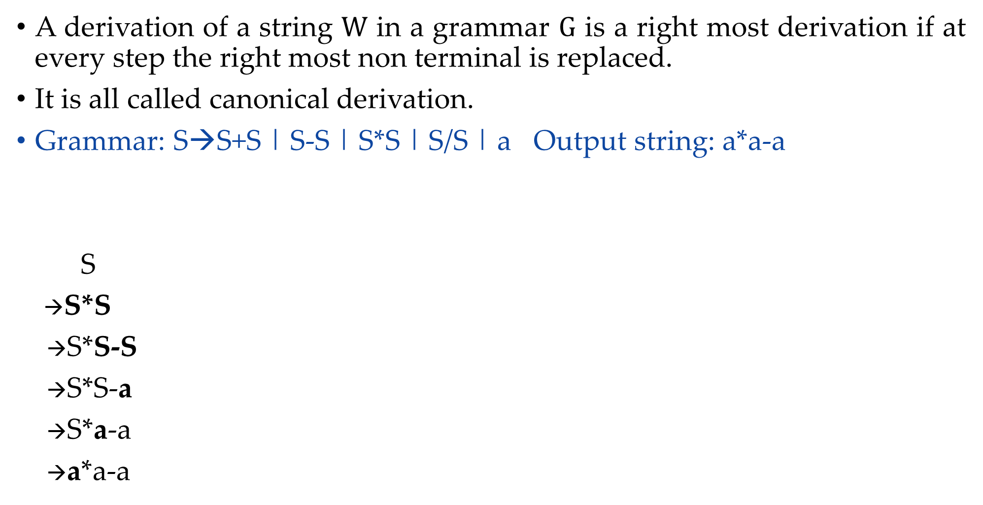
Rightmost derivation
A derivation of a string $W$ in a grammar $G$ is a right most derivation if at every step the right most non terminal is replaced.
It is all called canonical derivation.
Grammar: S→S+S | S-S | S*S | S/S | a Output string: a*a-a
S
→S*S
→S*S-S
→S*S-a
→S*a-a
→a*a-a
S
S
*
S
a
S
-
S
a
a
Parse Tree
Rightmost Derivation

Slide 13
Exercise: Derivation
Perform leftmost derivation and draw parse tree.
S→A1B
A→0A | 𝜖
B→0B | 1B | 𝜖
Output string: 1001
Perform leftmost derivation and draw parse tree.
S→0S1 | 01 Output string: 000111
Perform rightmost derivation and draw parse tree.
E→E+E | E*E | id | (E) | -E
Output string: id + id * id

Slide 14



Ambiguity
Ambiguity, is a word, phrase, or statement which contains more than one meaning.
A long thin piece of potato
Chip
A small piece of silicon

Slide 15
Ambiguity
A grammar that produces more than one parse tree for some sentence is said to be ambiguous.
An ambiguous grammar is one that produces more than one leftmost derivation or more than one rightmost derivation for the same sentence.
Sometimes an ambiguous grammar can be rewritten to eliminate the ambiguity.
Grammar for Conditional Statement
stmt -> if expr then stmt
| if expr then stmt else stmt
| other

Slide 16
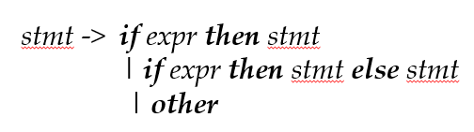
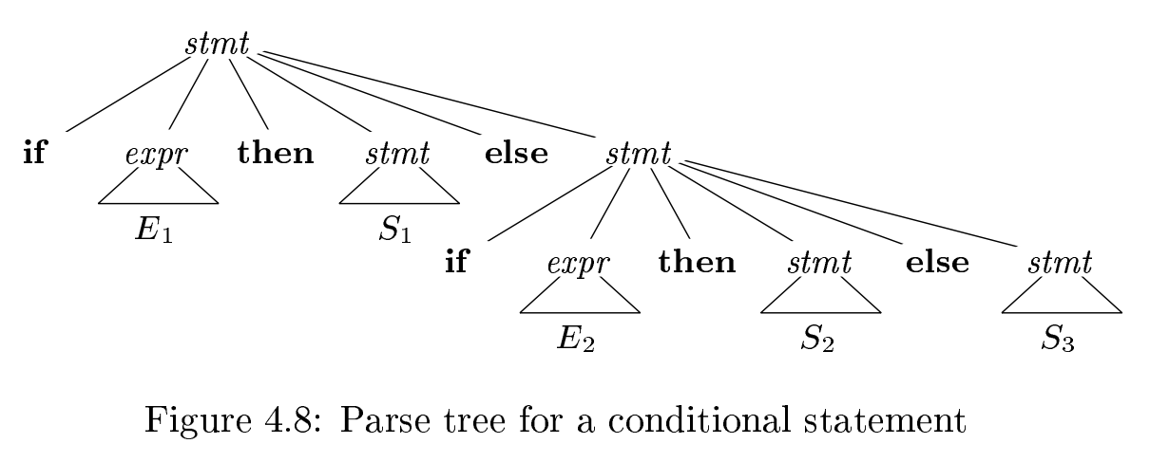
According to this grammar, the compound conditional statement
if E1 then S1 else if E2 then S2 else S3

Slide 17
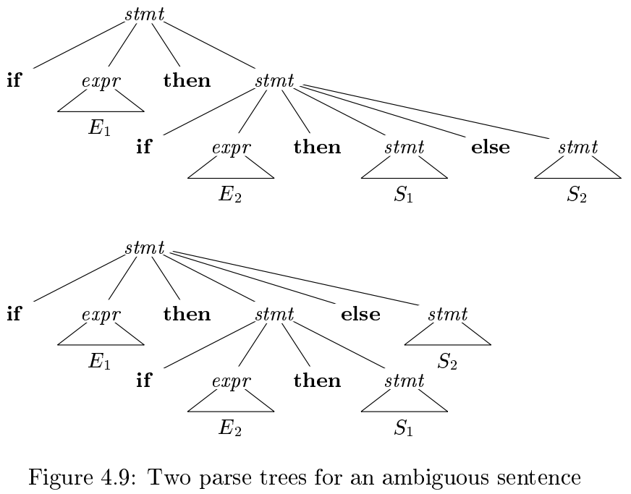
if E1 then if E2 then S1 else S2 has two parse trees. So the Previous grammar is ambiguous

Slide 18





Ambiguity
In formal language grammar, ambiguity would arise if identical string can occur on the RHS of two or more productions.
Grammar:
$N1→α$
$N2→α$
$α$ can be derived from either N1 or N2
$$N1$$
$$N2$$
Replaced by
$N1$ or $N2$ ?
$$α$$

Slide 19
Ambiguous grammar
Ambiguous grammar is one that produces more than one leftmost or more then one rightmost derivation for the same sentence.
Grammar: S→S+S | S*S | (S) | a Output string: a+a*a
S S
→S*S →S+S
→S+S*S →a+S
→a+S*S →a+S*S
→a+a*S →a+a*S
→a+a*a →a+a*a
Here, Two leftmost derivation for string a+a*a is possible hence, above grammar is ambiguous.
S
S
S
*
S
S
+
S
S
+
S
a
a
S
*
S
a
a
a
a

Slide 20
Exercise: Ambiguous Grammar
Check Ambiguity in following grammars:
S→ aS | Sa | 𝜖 (output string: aaaa)
S→ aSbS | bSaS | 𝜖 (output string: abab)
S→ SS+ | SS* | a (output string: aa+a*)
<exp> → <exp> + <term> | <term>
<term> → <term> * <letter> | <letter>
<letter> → a|b|c|…|z (output string: a+b*c)
Prove that the CFG with productions: S → a | Sa | bSS | SSb | SbS is ambiguous (Hint: consider output string yourself)

Slide 21
Left recursion & Left factoring

Slide 22



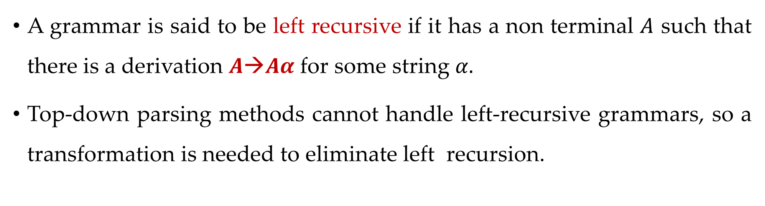
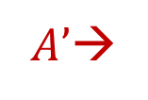


Left recursion
A grammar is said to be left recursive if it has a non terminal $A$ such that there is a derivation $A→Aα$for some string $α.$
Top-down parsing methods cannot handle left-recursive grammars, so a transformation is needed to eliminate left recursion.
$$A→Aα | β$$
$A→$
β$A’$
$|$𝜖
$A’$→
$$αA’$$

Slide 23
Examples: Left recursion elimination
E→E+T | T
E→TE’
E’→+TE’ | ε
T→T*F | F
T→FT’
T’→*FT’ | ε
X→X%Y | Z
X→ZX’
X’→%YX’ | ε

Slide 24
Exercise: Left recursion
A→Abd | Aa | a
B→Be | b
A→AB | AC | a | b
S→A | B
A→ABC | Acd | a | aa
B→Bee | b
Exp→Exp+term | Exp-term | term

Slide 25
Left factoring
Left factoring is a grammar transformation that is useful for producing a grammar suitable for predictive parsing.
S→aAB | aCD
S→aS’
S’→AB | CD
A→ xByA | xByAzA | a
A→ xByAA’ | a
A’→ Є | zA
A→ aAB | aA |a
A→aA’
A’→AB | A | 𝜖
A→aA’
A’→AA’’ | 𝜖
A’’→B | 𝜖

Slide 26
Exercise
S→iEtS | iEtSeS | a
A→ ad | a | ab | abc | x

Slide 27
Parsing
Parsing is a technique that takes input string and produces output either a parse tree if string is valid sentence of grammar, or an error message indicating that string is not a valid.
Types of parsing are:
Top down parsing: In top down parsing parser build parse tree from top to bottom.
Bottom up parsing: Bottom up parser starts from leaves and work up to the root.

Slide 28
Classification of parsing methods
Parsing
Top down parsing
Bottom up parsing (Shift reduce)
Back tracking
Operator precedence
Parsing without backtracking (predictive parsing)
LR parsing
SLR
LL(1)
CLR
Recursive
descent
LALR

Slide 29
Backtracking
In backtracking, expansion of nonterminal symbol we choose one alternative and if any mismatch occurs then we try another alternative.
Grammar: S→ cAd Input string: cad
A→ ab | a
S
S
S
c
A
d
c
A
d
c
A
d
Make prediction
Make prediction
a
b
Backtrack
a
Parsing done

Slide 30
Exercise
E→ 5+T | 3-T
T→ V | V*V | V+V
V→ a | b
String: 3-a+b

Slide 31
Parsing Methods
Parsing
Top down parsing
Bottom up parsing (Shift reduce)
Back tracking
Operator precedence
Parsing without backtracking (predictive parsing)
LR parsing
SLR
LL(1)
CLR
Recursive
descent
LALR

Slide 32
LL(1) parser (predictive parser)
LL(1) is non recursive top down parser.
First L indicates input is scanned from left to right.
The second L means it uses leftmost derivation for input string
1 means it uses only input symbol to predict the parsing process.
a | + | b | $
INPUT
X
Y
Z
$
Predictive parsing program
Stack
OUTPUT
Parsing table M

Slide 33
LL(1) parsing (predictive parsing)
Steps to construct LL(1) parser
Remove left recursion / Perform left factoring (if any).
Compute FIRST and FOLLOW of non terminals.
Construct predictive parsing table.
Parse the input string using parsing table.

Slide 34
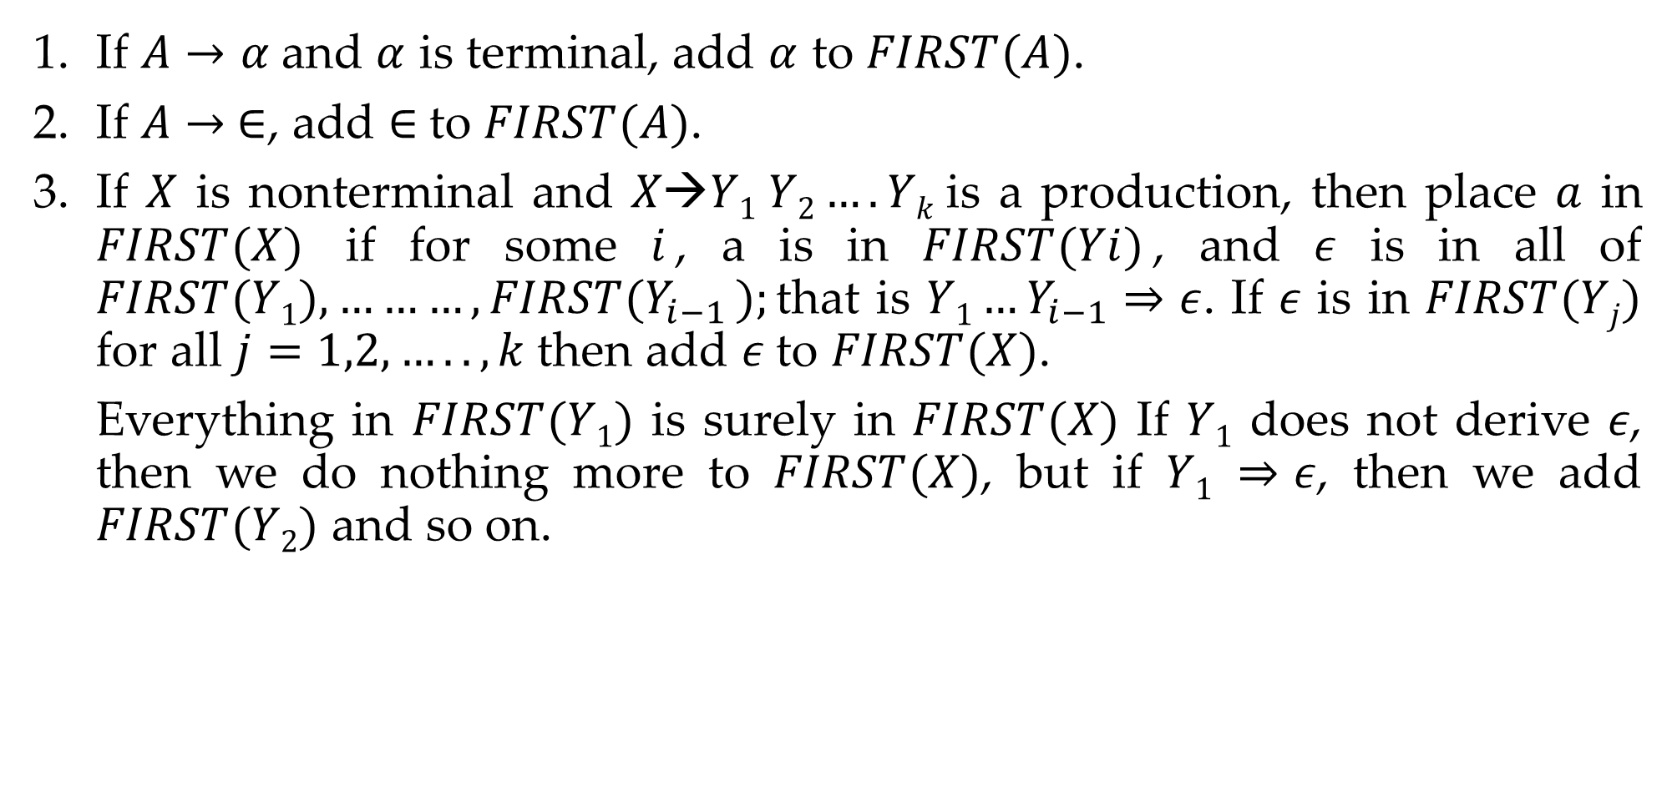
Rules to compute first of non terminal
If $A→α$and $α$ is terminal, add $α$ to $FIRST(A)$.
If $A→ ∈$, add $∈$to $FIRST(A)$.
If $X$ is nonterminal and $X→Y1 Y2….Yk$is a production, then place $a$ in $FIRST(X)$ if for some $i$, a is in $FIRST(Yi)$, and 𝜖 is in all of $FIRST(Y1),………,FIRST(Y_{i−1} );$that is $Y1…Y_{i−1}⇒ε$. If 𝜖 is in $FIRST(Yj)$ for all $j=1,2,…..,k$then add 𝜖 to $FIRST(X)$.
Everything in $FIRST(Y1)$ is surely in $FIRST(X)$ If $Y1$ does not derive 𝜖, then we do nothing more to $FIRST(X)$, but if $Y1 ⇒ε$, then we add $FIRST(Y2)$ and so on.

Slide 35
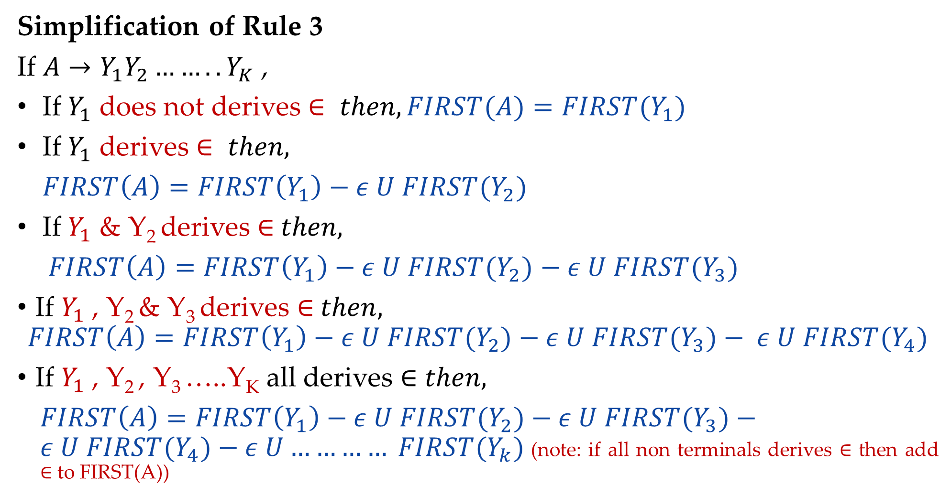
Rules to compute first of non terminal
Simplification of Rule 3
If $A→Y_{1}Y_{2}……..Y_{K}$ ,
If $Y_{1}$ does not derives $∈ then, FIRST(A)=FIRST{(Y}_{1})$
If $Y_{1}$ derives $∈ then,$
$FIRST\left(A\right)=FIRST\left(Y_{1}\right)−ε U FIRST{(Y}_{2})$
If $Y_{1}$ & Y₂ derives ∈$then,$
$FIRST\left(A\right)=FIRST\left(Y_{1}\right)−ε U FIRST{(Y}_{2})$ $− ε U FIRST{(Y}_{3})$
If $Y_{1}$ , Y₂ & Y₃ derives ∈$then,$
$$FIRST\left(A\right)=FIRST\left(Y_{1}\right)−ε U FIRST{(Y}_{2})−ε U FIRST{(Y}_{3})− ε U FIRST{(Y}_{4})$$
If $Y_{1}$ , Y₂ , Y₃ …..Y_{K} all derives ∈ $then,$
$FIRST\left(A\right)=FIRST\left(Y_{1}\right)−ε U FIRST{(Y}_{2})−ε U FIRST{(Y}_{3})−ε U FIRST{(Y}_{4})−ε U………… FIRST{(Y}_{k})$(note: if all non terminals derives ∈ then add ∈ to FIRST(A))

Slide 36

Rules to compute FOLLOW of non terminal
Place $\$ in follow\left(S\right). ($S is start symbol)
If $A→αBβ ,$then everything in $FIRST(β)$ except for 𝜖 is placed in $FOLLOW(B)$
If there is a production$A→αB$ or a production $A→αBβ$ where $FIRST(β)$ contains $ε$ then everything in $FOLLOW\left(A\right)=FOLLOW\left(B\right)$

Slide 37











How to apply rules to find FOLLOW of non terminal?
$$A→αBβ$$
$$β is absent$$
$$β is present$$
$$Rule 3$$
$$β is terminal$$
$$β is Nonterminal$$
$$Rule 2$$
$β does not derives$ 𝜖
$β derives$ 𝜖
$$Rule 2$$
$$Rule 2+Rule 3$$

Slide 38
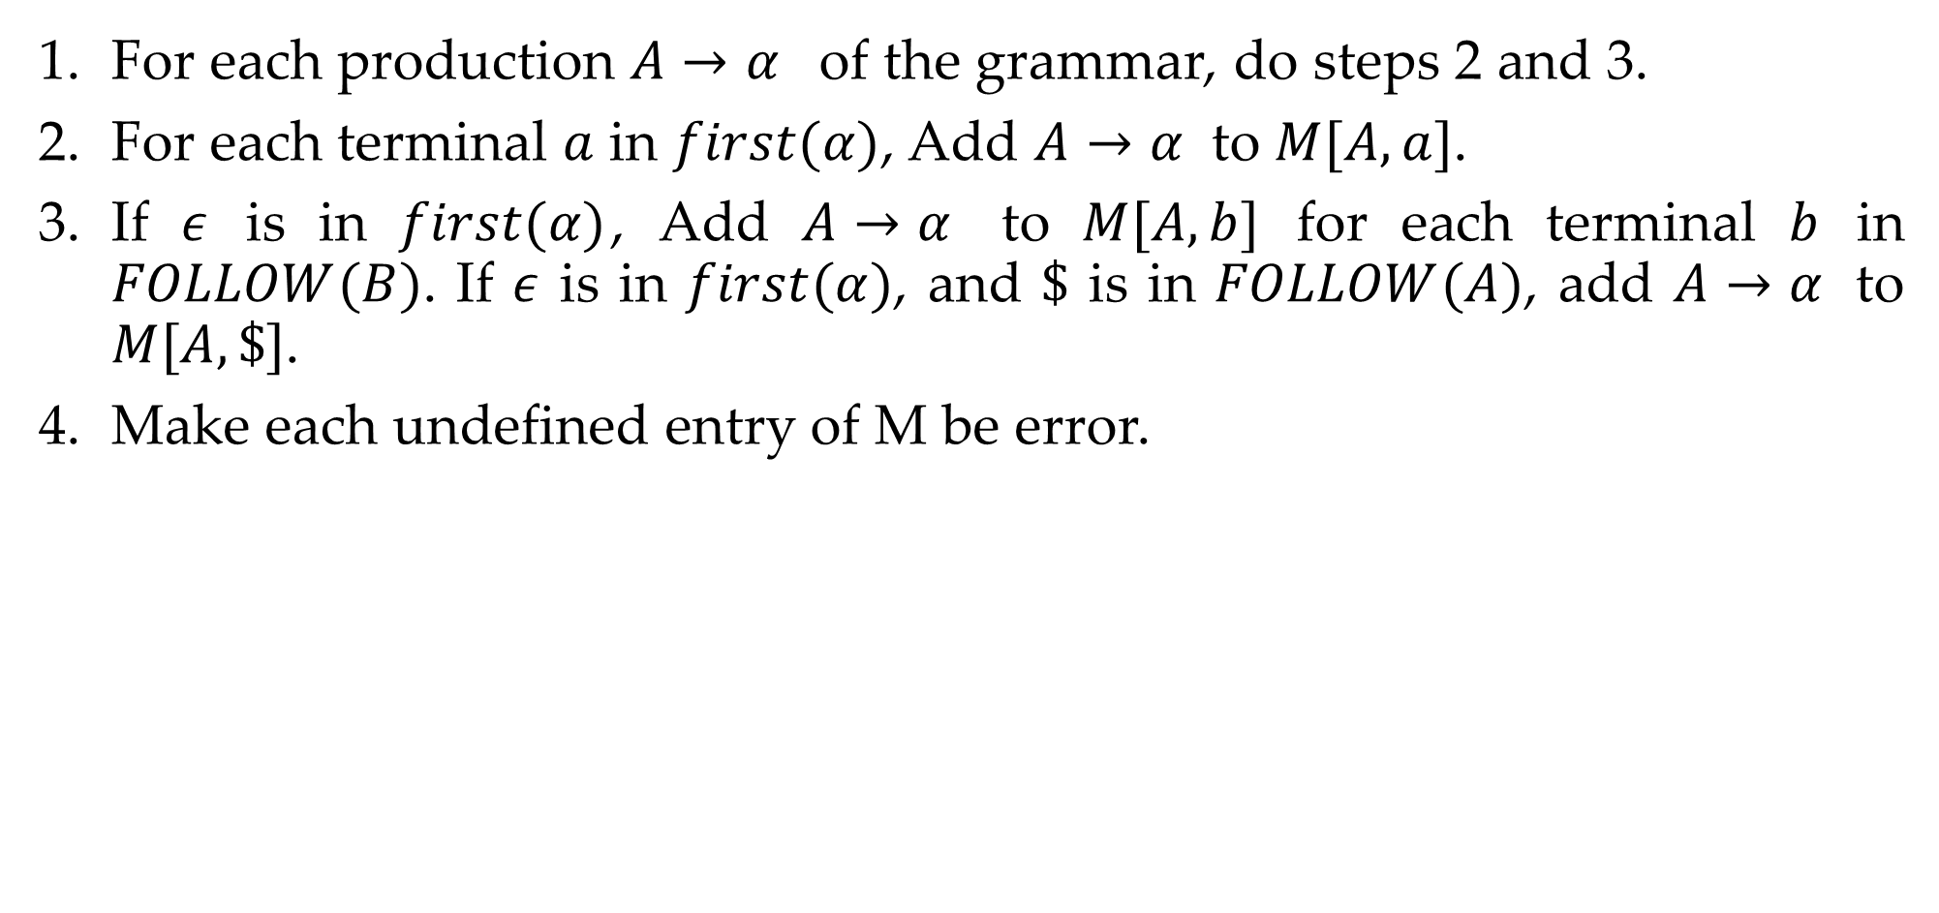
Rules to construct predictive parsing table
For each production $A→α$ of the grammar, do steps 2 and 3.
For each terminal $a$ in $first(α)$, Add $A→α$ to $M[A,a]$.
If $ε$ is in $first(α)$, Add $A→α$ to $M[A,b]$ for each terminal $b$ in $FOLLOW(B)$. If $ε$ is in $first(α)$, and $\$$ is in $FOLLOW(A)$, add $A→α$ to $M[A,\$]$.
Make each undefined entry of M be error.

Slide 39
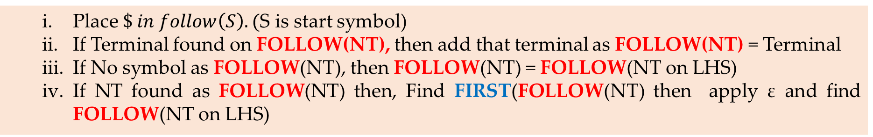
Steps to construct LL(1) parsing (predictive parsing)
Remove left recursion / Perform left factoring (if any).
Compute FIRST and FOLLOW of non terminals.
a. FIRST
If S-> aSBc, B-> ε then FIRST(S) ={a}, FIRST(B)={ε}
If A->Bxy, B->MN,M->z then FIRST(A)= FIRST(B)= FIRST(M)={z}
b. FOLLOW
Construct predictive parsing table.
Parse the input string using parsing table.
Place $\$ in follow\left(S\right). ($S is start symbol)
If Terminal found on FOLLOW(NT), then add that terminal as FOLLOW(NT) = Terminal
If No symbol as FOLLOW(NT), then FOLLOW(NT) = FOLLOW(NT on LHS)
If NT found as FOLLOW(NT) then, Find FIRST(FOLLOW(NT) then apply ε and find FOLLOW(NT on LHS)
For each N.T, if FIRST(NT) is not ε then for each symbols of FIRST(NT_{RHS}) update its production in the parsing table.
If FIRST(NT) is ε, the for each symbols of FOLLOW(NT_{LHS}) update its production in the parsing table.
Make each undefined entry of Parsing Table as error.

Slide 40






Example-1: LL(1) parsing
S→aBa
B→bB | ϵ
Step 1: Not required
Step 2: Compute FIRST
First(S)
S→aBa
First(B)
B→bB B→𝜖
NT | First
S | { a }
B | {b,𝜖}
S | → | a | B | a
Rule 1
add $α$ to $FIRST(A)$
A | → | $$α$$
FIRST(S)={ a }
B | → | b | B
B | → | 𝜖
Rule 1
add $α$ to $FIRST(A)$
A | → | $$α$$
A | → | $$ε$$
Rule 2
add $ε$ to $FIRST(A)$
FIRST(B)={ b
, 𝜖 }

Slide 41


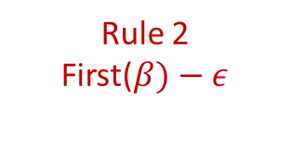
Example-1: LL(1) parsing
S→aBa
B→bB | ϵ
Step 2: Compute FOLLOW
Follow(S)
Follow(B)
S→aBa B→bB
NT | First | Follow
S | {a} | {$}
B | {b,𝜖} | {a}
Rule 1: Place $ in FOLLOW(S)
Follow(S)={ $ }
S | → | a | B | a
B | → | b | B
Rule 3
Follow(A)=follow(B)
A | → | $$α$$ | B | $$β$$
Rule 2
First($β)−ε$
A | → | $$α$$ | B
Follow(B)={ a
}

Slide 42

Example-1: LL(1) parsing
S→aBa
B→bB | ϵ
Step 3: Prepare predictive parsing table
S→aBa
a=FIRST(aBa)={ a }
M[S,a]=S→aBa
NT | First | Follow
S | {a} | {$}
B | {b,𝜖} | {a}
NT | Input Symbol
 | a | b | $
S | S→aBa
B
Rule: 2
A→ $α$
a = first($α$)
M[A,a] = A→ $α$

Slide 43
Example-1: LL(1) parsing
S→aBa
B→bB | ϵ
Step 3: Prepare predictive parsing table
B→bB
a=FIRST(bB)={ b }
M[B,b]=B→bB
NT | First | Follow
S | {a} | {$}
B | {b,𝜖} | {a}
NT | Input Symbol
 | a | b | $
S | S→aBa
B |  | B→bB
Rule: 2
A→ $α$
a = first($α$)
M[A,a] = A→ $α$

Slide 44

Example-1: LL(1) parsing
S→aBa
B→bB | ϵ
Step 3: Prepare predictive parsing table
B→ϵ
b=FOLLOW(B)={ a }
M[B,a]=B→𝜖
NT | First | Follow
S | {a} | {$}
B | {b,𝜖} | {a}
NT | Input Symbol
 | a | b | $
S | S→aBa | Error | Error
B | B→ϵ | B→bB | Error
Rule: 3
A→ $α$
b = follow(A)
M[A,b] = A→ $α$

Slide 45




Example-2: LL(1) parsing
Step 1: Not required
Step 2: Compute FIRST
First(S)
S→aB S→𝜖
S→aB | ϵ
B→bC | ϵ
C→cS | ϵ
NT | First
S | { a, 𝜖 }
B | {b,𝜖}
C | {c,𝜖}
S | → | a | B
S | → | 𝜖
Rule 1
add $α$ to $FIRST(A)$
Rule 2
add $ε$ to $FIRST(A)$
A | → | $$α$$
A | → | $$ε$$
FIRST(S)={ a
, 𝜖 }

Slide 46
Example-2: LL(1) parsing
Step 1: Not required
Step 2: Compute FIRST
First(B)
B→bC B→𝜖
S→aB | ϵ
B→bC | ϵ
C→cS | ϵ
NT | First
S | { a, 𝜖 }
B | {b,𝜖}
C | {c,𝜖}
B | → | b | C
B | → | 𝜖
Rule 1
add $α$ to $FIRST(A)$
Rule 2
add $ε$ to $FIRST(A)$
A | → | $$α$$
A | → | $$ε$$
FIRST(B)={ b
, 𝜖 }

Slide 47
Example-2: LL(1) parsing
Step 1: Not required
Step 2: Compute FIRST
First(C)
C→cS C→𝜖
S→aB | ϵ
B→bC | ϵ
C→cS | ϵ
NT | First
S | { a, 𝜖 }
B | {b,𝜖}
C | {c,𝜖}
C | → | c | S
C | → | 𝜖
Rule 1
add $α$ to $FIRST(A)$
Rule 2
add $ε$ to $FIRST(A)$
A | → | $$α$$
A | → | $$ε$$
FIRST(B)={ c
, 𝜖 }

Slide 48



Example-2: LL(1) parsing
Step 2: Compute FOLLOW
Follow(S)
C→cS
B→bC S→aB
Rule 1: Place $ in FOLLOW(S)
Follow(S)={ $ }
S→aB | ϵ
B→bC | ϵ
C→cS | ϵ
C | → | c | S
Rule 3
Follow(A)=follow(B)
A | → | $$α$$ | B
Follow(S)=Follow(C)
={$}
NT | First | Follow
S | {a,𝜖} | {$}
B | {b,𝜖} | {$}
C | {c,𝜖} | {$}
B | → | b | C
Rule 3
Follow(A)=follow(B)
S | → | a | B
Rule 3
Follow(A)=follow(B)
A | → | $$α$$ | B
A | → | $$α$$ | B
Follow(C)=Follow(B)
={$}
Follow(B)=Follow(S)
={$}

Slide 49

Example-2: LL(1) parsing
Step 3: Prepare predictive parsing table
S→aB
a=FIRST(aB)={ a }
M[S,a]=S→aB
S→aB | ϵ
B→bC | ϵ
C→cS | ϵ
NT | First | Follow
S | {a,𝜖} | {$}
B | {b,𝜖} | {$}
C | {c,𝜖} | {$}
NT | Input Symbol
 | a | b | c | $
S | S→aB
B
C
Rule: 2
A→ $α$
a = first($α$)
M[A,a] = A→ $α$

Slide 50

Example-2: LL(1) parsing
Step 3: Prepare predictive parsing table
S→𝜖
b=FOLLOW(S)={ $ }
M[S,$]=S→𝜖
S→aB | ϵ
B→bC | ϵ
C→cS | ϵ
NT | First | Follow
S | {a} | {$}
B | {b,𝜖} | {$}
C | {c,𝜖} | {$}
NT | Input Symbol
 | a | b | c | $
S | S→aB |  |  | S→𝜖
B
C
Rule: 3
A→ $α$
b = follow(A)
M[A,b] = A→ $α$

Slide 51
Example-2: LL(1) parsing
Step 3: Prepare predictive parsing table
B→bC
a=FIRST(bC)={ b }
M[B,b]=B→bC
S→aB | ϵ
B→bC | ϵ
C→cS | ϵ
NT | First | Follow
S | {a} | {$}
B | {b,𝜖} | {$}
C | {c,𝜖} | {$}
NT | Input Symbol
 | a | b | c | $
S | S→aB |  |  | S→𝜖
B |  | B→bC
C
Rule: 2
A→ $α$
a = first($α$)
M[A,a] = A→ $α$

Slide 52
Example-2: LL(1) parsing
Step 3: Prepare predictive parsing table
B→𝜖
b=FOLLOW(B)={ $ }
M[B,$]=B→𝜖
S→aB | ϵ
B→bC | ϵ
C→cS | ϵ
NT | First | Follow
S | {a} | {$}
B | {b,𝜖} | {$}
C | {c,𝜖} | {$}
NT | Input Symbol
 | a | b | c | $
S | S→aB |  |  | S→𝜖
B |  | B→bC |  | B→𝜖
C
Rule: 3
A→ $α$
b = follow(A)
M[A,b] = A→ $α$

Slide 53
Example-2: LL(1) parsing
Step 3: Prepare predictive parsing table
C→cS
a=FIRST(cS)={ c }
M[C,c]=C→cS
S→aB | ϵ
B→bC | ϵ
C→cS | ϵ
NT | First | Follow
S | {a} | {$}
B | {b,𝜖} | {$}
C | {c,𝜖} | {$}
NT | Input Symbol
 | a | b | c | $
S | S→aB |  |  | S→𝜖
B |  | B→bC |  | B→𝜖
C |  |  | C→cS
Rule: 2
A→ $α$
a = first($α$)
M[A,a] = A→ $α$

Slide 54
Example-2: LL(1) parsing
Step 3: Prepare predictive parsing table
C→𝜖
b=FOLLOW(C)={ $ }
M[C,$]=C→𝜖
S→aB | ϵ
B→bC | ϵ
C→cS | ϵ
NT | First | Follow
S | {a} | {$}
B | {b,𝜖} | {$}
C | {c,𝜖} | {$}
NT | Input Symbol
 | a | b | c | $
S | S→aB | Error | Error | S→𝜖
B | Error | B→bB | Error | B→𝜖
C | Error | Error | C→cS | C→𝜖
Rule: 3
A→ $α$
b = follow(A)
M[A,b] = A→ $α$

Slide 55
Example-3: LL(1) parsing
E→E+T | T
T→T*F | F
F→(E) | id
Step 1: Remove left recursion
E→TE’
E’→+TE’ | ϵ
T→FT’
T’→*FT’ | ϵ
F→(E) | id

Slide 56




Example-3: LL(1) parsing
Step 2: Compute FIRST
First(E)
E→TE’
First(T)
T→FT’
First(F)
F→(E) F→id
E→TE’
E’→+TE’ | ϵ
T→FT’
T’→*FT’ | ϵ
F→(E) | id
E | → | T | E’
Rule 3
First(A)=First(Y1)
A | → | Y₁ | Y₂
FIRST(E)=FIRST(T)
= {(, id }
NT | First
E | { (,id }
T | → | F | T’
Rule 3
First(A)=First(Y1)
E’
A | → | Y₁ | Y₂
T | { (,id }
FIRST(T)=FIRST(F)
= {(, id }
T’
F | { (,id }
F | → | ( | E | )
F | → | id
A | → | $$α$$
Rule 1
add $α$ to $FIRST(A)$
A | → | $$α$$
Rule 1
add $α$ to $FIRST(A)$
FIRST(F)={ (
, id }

Slide 57





Example-3: LL(1) parsing
Step 2: Compute FIRST
First(E’)
E’→+TE’
E’→𝜖
E→TE’
E’→+TE’ | ϵ
T→FT’
T’→*FT’ | ϵ
F→(E) | id
E’ | → | + | T | E’
Rule 1
add $α$ to $FIRST(A)$
A | → | $$α$$
NT | First
E | { (,id }
E’ | { +, 𝜖 }
T | { (,id }
T’
E’ | → | $$ε$$
Rule 2
add $ε$ to $FIRST(A)$
F | { (,id }
A | → | $$ε$$
FIRST(E’)={ +
, 𝜖 }

Slide 58

Example-3: LL(1) parsing
Step 2: Compute FIRST
First(T’)
T’→*FT’
T’→𝜖
E→TE’
E’→+TE’ | ϵ
T→FT’
T’→*FT’ | ϵ
F→(E) | id
T’ | → | * | F | T’
Rule 1
add $α$ to $FIRST(A)$
A | → | $$α$$
NT | First
E | { (,id }
E’ | { +, 𝜖 }
T | { (,id }
T’ | { *, 𝜖 }
T’ | → | $$ε$$
Rule 2
add $ε$ to $FIRST(A)$
F | { (,id }
A | → | $$ε$$
FIRST(T’)={ *
, 𝜖 }

Slide 59

Example-3: LL(1) parsing
Step 2: Compute FOLLOW
FOLLOW(E)
F→(E)
E→TE’
E’→+TE’ | ϵ
T→FT’
T’→*FT’ | ϵ
F→(E) | id
Rule 1: Place $ in FOLLOW(E)
NT | First | Follow
E | { (,id } | { $,) }
E’ | { +, 𝜖 }
F | → | ( | E | )
Rule 2
T | { (,id }
A | → | $$α$$ | B | $$β$$
T’ | { *, 𝜖 }
F | { (,id }
FOLLOW(E)={ $,
) }

Slide 60


Example-3: LL(1) parsing
E→TE’
E’→+TE’ | ϵ
T→FT’
T’→*FT’ | ϵ
F→(E) | id
Step 2: Compute FOLLOW
FOLLOW(E’)
E→TE’
E’→+TE’
NT | First | Follow
E | → | T | E’
Rule 3
E | { (,id } | { $,) }
A | → | $$α$$ | B
E’ | { +, 𝜖 } | { $,) }
T | { (,id }
T’ | { *, 𝜖 }
F | { (,id }
E’ | → | +T | E’
Rule 3
A | → | $$α$$ | B
}
FOLLOW(E’)={ $,)

Slide 61


Example-3: LL(1) parsing
Step 2: Compute FOLLOW
FOLLOW(T)
E→TE’
E→TE’
E’→+TE’ | ϵ
T→FT’
T’→*FT’ | ϵ
F→(E) | id
NT | First | Follow
E | → |  | T | E’
Rule 2
E | { (,id } | { $,) }
A | → | $$α$$ | B | $$β$$
E’ | { +, 𝜖 } | { $,) }
T | { (,id }
T’ | { *, 𝜖 }
F | { (,id }
E | → |  | T | E’
Rule 3
A | → | $$α$$ | B | $$β$$
FOLLOW(T)={ +,
$, )

Slide 62


Example-3: LL(1) parsing
Step 2: Compute FOLLOW
FOLLOW(T)
E’→+TE’
E→TE’
E’→+TE’ | ϵ
T→FT’
T’→*FT’ | ϵ
F→(E) | id
NT | First | Follow
E’ | → | + | T | E’
Rule 2
E | { (,id } | { $,) }
A | → | $$α$$ | B | $$β$$
E’ | { +, 𝜖 } | { $,) }
T | { (,id } | { +,$,) }
T’ | { *, 𝜖 }
F | { (,id }
E’ | → | + | T | E’
Rule 3
A | → | $$α$$ | B | $$β$$
}
FOLLOW(T)={ +,
$, )

Slide 63


Example-3: LL(1) parsing
Step 2: Compute FOLLOW
FOLLOW(T’)
T→FT’
T’→*FT’
E→TE’
E’→+TE’ | ϵ
T→FT’
T’→*FT’ | ϵ
F→(E) | id
NT | First | Follow
T | → | F | T’
Rule 3
E | { (,id } | { $,) }
A | → | $$α$$ | B
E’ | { +, 𝜖 } | { $,) }
T | { (,id } | { +,$,) }
T’ | { *, 𝜖 } | { +,$,) }
F | { (,id }
T’ | → | *F | T’
Rule 3
A | → | $$α$$ | B
}
FOLLOW(T’)={+ $,)

Slide 64

Example-3: LL(1) parsing
Step 2: Compute FOLLOW
FOLLOW(F)
T→FT’
E→TE’
E’→+TE’ | ϵ
T→FT’
T’→*FT’ | ϵ
F→(E) | id
NT | First | Follow
T | → |  | F | T’
Rule 2
E | { (,id } | { $,) }
A | → | $$α$$ | B | $$β$$
E’ | { +, 𝜖 } | { $,) }
T | { (,id } | { +,$,) }
T’ | { *, 𝜖 } | { +,$,) }
F | { (,id }
T | → |  | F | T’
Rule 3
A | → | $$α$$ | B | $$β$$
FOLLOW(F)={ *,
+ ,$ , )

Slide 65
Example-3: LL(1) parsing
Step 2: Compute FOLLOW
FOLLOW(F)
T’→*FT’
E→TE’
E’→+TE’ | ϵ
T→FT’
T’→*FT’ | ϵ
F→(E) | id
NT | First | Follow
T’ | → | * | F | T’
Rule 2
E | { (,id } | { $,) }
A | → | $$α$$ | B | $$β$$
E’ | { +, 𝜖 } | { $,) }
T | { (,id } | { +,$,) }
T’ | { *, 𝜖 } | { +,$,) }
F | { (,id } | {*,+,$,)}
T’ | → | * | F | T’
Rule 3
A | → | $$α$$ | B | $$β$$
}
FOLLOW(F)={ *,+,
$, )

Slide 66
Example-3: LL(1) parsing
Step 3: Construct predictive parsing table
E→TE’
a=FIRST(TE’)={ (,id }
M[E,(]=E→TE’
M[E,id]=E→TE’
E→TE’
E’→+TE’ | ϵ
T→FT’
T’→*FT’ | ϵ
F→(E) | id
NT | Input Symbol
 | id | + | * | ( | ) | $
E | E→TE’ |  |  | E→TE’
E’
T
T’
F
NT | First | Follow
E | { (,id } | { $,) }
E’ | { +, 𝜖 } | { $,) }
T | { (,id } | { +,$,) }
T’ | { *, 𝜖 } | { +,$,) }
Rule: 2
A→ $α$
a = first($α$)
M[A,a] = A→ $α$
F | { (,id } | {*,+,$,)}

Slide 67
Example-3: LL(1) parsing
Step 3: Construct predictive parsing table
E’→+TE’
a=FIRST(+TE’)={ + }
M[E’,+]=E’→+TE’
E→TE’
E’→+TE’ | ϵ
T→FT’
T’→*FT’ | ϵ
F→(E) | id
NT | Input Symbol
 | id | + | * | ( | ) | $
E | E→TE’ |  |  | E→TE’
E’ |  | E’→+TE’
T
T’
F
NT | First | Follow
E | { (,id } | { $,) }
E’ | { +, 𝜖 } | { $,) }
T | { (,id } | { +,$,) }
T’ | { *, 𝜖 } | { +,$,) }
Rule: 2
A→ $α$
a = first($α$)
M[A,a] = A→ $α$
F | { (,id } | {*,+,$,)}

Slide 68
Example-3: LL(1) parsing
Step 3: Construct predictive parsing table
E’→𝜖
b=FOLLOW(E’)={ $,) }
M[E’,$]=E’→𝜖
M[E’,)]=E’→𝜖
E→TE’
E’→+TE’ | ϵ
T→FT’
T’→*FT’ | ϵ
F→(E) | id
NT | Input Symbol
 | id | + | * | ( | ) | $
E | E→TE’ |  |  | E→TE’
E’ |  | E’→+TE’ |  |  | E’→𝜖 | E’→𝜖
T
T’
F
NT | First | Follow
E | { (,id } | { $,) }
E’ | { +, 𝜖 } | { $,) }
T | { (,id } | { +,$,) }
T’ | { *, 𝜖 } | { +,$,) }
Rule: 3
A→ $α$
b = follow(A)
M[A,b] = A→ $α$
F | { (,id } | {*,+,$,)}

Slide 69
Example-3: LL(1) parsing
Step 3: Construct predictive parsing table
T→FT’
a=FIRST(FT’)={ (,id }
M[T,(]=T→FT’
M[T,id]=T→FT’
E→TE’
E’→+TE’ | ϵ
T→FT’
T’→*FT’ | ϵ
F→(E) | id
NT | Input Symbol
 | id | + | * | ( | ) | $
E | E→TE’ |  |  | E→TE’
E’ |  | E’→+TE’ |  |  | E’→𝜖 | E’→𝜖
T | T→FT’ |  |  | T→FT’
T’
F
NT | First | Follow
E | { (,id } | { $,) }
E’ | { +, 𝜖 } | { $,) }
T | { (,id } | { +,$,) }
T’ | { *, 𝜖 } | { +,$,) }
Rule: 2
A→ $α$
a = first($α$)
M[A,a] = A→ $α$
F | { (,id } | {*,+,$,)}

Slide 70
Example-3: LL(1) parsing
Step 3: Construct predictive parsing table
T’→*FT’
a=FIRST(*FT’)={ * }
M[T’,*]=T’→*FT’
E→TE’
E’→+TE’ | ϵ
T→FT’
T’→*FT’ | ϵ
F→(E) | id
NT | Input Symbol
 | id | + | * | ( | ) | $
E | E→TE’ |  |  | E→TE’
E’ |  | E’→+TE’ |  |  | E’→𝜖 | E’→𝜖
T | T→FT’ |  |  | T→FT’
T’ |  |  | T’→*FT’
F
NT | First | Follow
E | { (,id } | { $,) }
E’ | { +, 𝜖 } | { $,) }
T | { (,id } | { +,$,) }
T’ | { *, 𝜖 } | { +,$,) }
Rule: 2
A→ $α$
a = first($α$)
M[A,a] = A→ $α$
F | { (,id } | {*,+,$,)}

Slide 71
Example-3: LL(1) parsing
Step 3: Construct predictive parsing table
T’→𝜖
b=FOLLOW(T’)={ +,$,) }
M[T’,+]=T’→𝜖
M[T’,$]=T’→𝜖
M[T’,)]=T’→𝜖
E→TE’
E’→+TE’ | ϵ
T→FT’
T’→*FT’ | ϵ
F→(E) | id
NT | Input Symbol
 | id | + | * | ( | ) | $
E | E→TE’ |  |  | E→TE’
E’ |  | E’→+TE’ |  |  | E’→𝜖 | E’→𝜖
T | T→FT’ |  |  | T→FT’
T’ |  | T’→𝜖 | T’→*FT’ |  | T’→𝜖 | T’→𝜖
F
NT | First | Follow
E | { (,id } | { $,) }
E’ | { +, 𝜖 } | { $,) }
T | { (,id } | { +,$,) }
T’ | { *, 𝜖 } | { +,$,) }
Rule: 3
A→ $α$
b = follow(A)
M[A,b] = A→ $α$
F | { (,id } | {*,+,$,)}

Slide 72
Example-3: LL(1) parsing
Step 3: Construct predictive parsing table
F→(E)
a=FIRST((E))={ ( }
M[F,(]=F→(E)
E→TE’
E’→+TE’ | ϵ
T→FT’
T’→*FT’ | ϵ
F→(E) | id
NT | Input Symbol
 | id | + | * | ( | ) | $
E | E→TE’ |  |  | E→TE’
E’ |  | E’→+TE’ |  |  | E’→𝜖 | E’→𝜖
T | T→FT’ |  |  | T→FT’
T’ |  | T’→𝜖 | T’→*FT’ |  | T’→𝜖 | T’→𝜖
F |  |  |  | F→(E)
NT | First | Follow
E | { (,id } | { $,) }
E’ | { +, 𝜖 } | { $,) }
T | { (,id } | { +,$,) }
T’ | { *, 𝜖 } | { +,$,) }
Rule: 2
A→ $α$
a = first($α$)
M[A,a] = A→ $α$
F | { (,id } | {*,+,$,)}

Slide 73
Example-3: LL(1) parsing
Step 3: Construct predictive parsing table
F→id
a=FIRST(id)={ id }
M[F,id]=F→id
E→TE’
E’→+TE’ | ϵ
T→FT’
T’→*FT’ | ϵ
F→(E) | id
NT | Input Symbol
 | id | + | * | ( | ) | $
E | E→TE’ |  |  | E→TE’
E’ |  | E’→+TE’ |  |  | E’→𝜖 | E’→𝜖
T | T→FT’ |  |  | T→FT’
T’ |  | T’→𝜖 | T’→*FT’ |  | T’→𝜖 | T’→𝜖
F | F→id |  |  | F→(E)
NT | First | Follow
E | { (,id } | { $,) }
E’ | { +, 𝜖 } | { $,) }
T | { (,id } | { +,$,) }
T’ | { *, 𝜖 } | { +,$,) }
Rule: 2
A→ $α$
a = first($α$)
M[A,a] = A→ $α$
F | { (,id } | {*,+,$,)}

Slide 74
Example-3: LL(1) parsing
Step 4: Make each undefined entry of table be Error
NT | Input Symbol
 | id | + | * | ( | ) | $
E | E→TE’ | Error | Error | E→TE’ | Error | Error
E’ | Error | E’→+TE’ | Error | Error | E’→𝜖 | E’→𝜖
T | T→FT’ | Error | Error | T→FT’ | Error | Error
T’ | Error | T’→𝜖 | T’→*FT’ | Error | T’→𝜖 | T’→𝜖
F | F→id | Error | Error | F→(E) | Error | Error

Slide 75
Example-3: LL(1) parsing
Step 5: Parse the string : id + id * id $
NT | Input Symbol
 | id | + | * | ( | ) | $
E | E→TE’ | Error | Error | E→TE’ | Error | Error
E’ | Error | E’→+TE’ | Error | Error | E’→𝜖 | E’→𝜖
T | T→FT’ | Error | Error | T→FT’ | Error | Error
T’ | Error | T’→𝜖 | T’→*FT’ | Error | T’→𝜖 | T’→𝜖
F | F→id | Error | Error | F→(E) | Error | Error
STACK | INPUT | OUTPUT
E$ | id+id*id$
TE’$ | id+id*id$ | E→TE’
FT’E’$ | id+id*id$ | T→FT’
idT’E’$ | id+id*id$ | F→id
T’E’$ | +id*id$
E’$ | +id*id$ | T’→𝜖
+TE’$ | +id*id$ | E’→+TE’
TE’$ | id*id$
FT’E’$ | id$
FT’E’$ | id*id$ | T→FT’
idT’E’$ | id$ | F→id
idT’E’$ | id*id$ | F→id
T’E’$ | $
T’E’$ | *id$
E’$ | $ | T’→𝜖
*FT’E’$ | *id$ | T→*FT’
$ | $ | E’→𝜖

Slide 76
Exercise
Construct parsing table for the following grammar:
S -> aABb
A -> c | €
B -> d | €
Construct parsing table for the following grammar:
S -> AaAb | BbBa
A -> €
B -> €
Construct parsing table for the following grammar:
S -> AB |eDa
A -> ab |c
B -> dC
C -> eC | €
D -> fD | €

Slide 77
Solution to Ex: 1
S -> aABb A -> c | € B -> d | €
Step: 1: No left recursion in the grammar, hence no modification required.
Step 2: Calculation of First Set
First(S) = {a}
First(A) = {c, €}
First(B) = {d, €}

Slide 78
Step 3: Calculation of Follow Set Follow(S) = {$}
Follow(A) = First(Bb) = First(B) = {d, €)
Since it contains €, continue FIRST rule. First(Bb) = First(B) - € U First (b) = {d, b} Follow(A) = {d,b}
Follow(B)= {b}
Step 4: Parsing Table
Grammar is LL(1)
Example String: acdb$ H/w string: adb$
 | a | b | c | d | $
S | S->aABb
A |  | A->€ | A->c | A->€
B |  | B->€ |  | B->d

Slide 79
Example String: acdb$
 | a | b | c | d | $
S | S->aABb
A |  | A->€ | A->c | A->€
B |  | B->€ |  | B->d
Stack | Input | Action
$ | acdb$ | Push S into Stack
$S | acdb$ | S->aABb
$bBAa | acdb$ | Pop a
$bBA | cdb$ | A->c
$bBc | cdb$ | Pop c
$bB | db$ | B->d
$bd | db$ | Pop d
$b | b$ | Pop b
$ | $ | Accept

Slide 80
Solution to Ex: 2
S -> AaAb | BbBa
A -> €
B -> €
Step: 1: No left recursion in the grammar, hence no modification required.
Step 2: Calculation of First Set First(S) = First(AaAb) U First(BbBa) First(AaAb) = First(A) = €
Since it contains €, continue FIRST rule First(AaAb) = First(A) - € U First(aAb) = {a} Similarly: First(BbBa) = {b}
First(S) = {a,b}

Slide 81
Step 3: Calculation of Follow Set Follow(S) = {$}
Follow(A) = First(aAb) = a
Follow(A) = {a,b}
Similarly,
Follow(B) = {a,b}
Step 4:Construction of Parsing Table: Grammar is LL(1)
Follow(A) = First(b) = {b}
 | a | b | $
S | S->AaAb | S->BbBa
A | A->€ | A->€
B | B->€ | B->€

Slide 82
Solution to Ex: 3
S -> AB |eDa
A -> ab |c
B -> dC
C -> eC | €
D -> fD | €
Step: 1: No left recursion in the grammar, hence no modification required.
Step 2: Calculation of First Set
First(S) = {a,c,e}
First(A) = {a,c}
First(B) = {d}
First(C) = {e, €}
First(D) = {f, €}

Slide 83
Step 3: Calculation of Follow Set
Follow(S) = {$}
S->AB
Follow(A) = First(B) = {d} Follow(B) = Follow(S) = {$}
S->eDA
Follow(D) = First(a) = {a}
B->dC
Follow(C) = Follow(B) = {$}
C->eC
Follow(C) = Follow(C) = {$}
D->fD
Follow(D) = Follow(D) = {a}
Parsing Table
 | a | b | c | d | e | f | $
S | S->AB |  | S->AB |  | S->eDa
A | A->ab |  | A->c
B |  | B->dC
C |  |  |  |  | C->eC |  | C->€
D | D->€ |  |  |  |  | D->fD

Slide 84
Parsing methods
Parsing
Top down parsing
Bottom up parsing (Shift reduce)
Back tracking
Operator precedence
Parsing without backtracking (predictive parsing)
LR parsing
SLR
LL(1)
CLR
Recursive
descent
LALR

Slide 85
Recursive descent parsing
A top down parsing that executes a set of recursive procedure to process the input without backtracking is called recursive descent parser.
There is a procedure for each non terminal in the grammar.
Consider RHS of any production rule as definition of the procedure.
As it reads expected input symbol, it advances input pointer to next input position.
The term descent refers to the direction in which the parse tree is built.
It builds the parse tree from the root to the leaf.

Slide 86
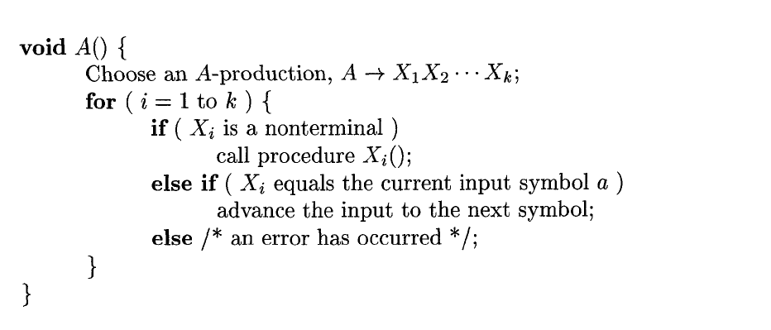
Cont.,

Slide 87
Example: Recursive descent parsing
Procedure E
{
If lookahead=num
{
Match(num);
T();
}
Else
Error();
If lookahead=$
{
Declare success;
}
Else
Error();
}
Procedure T
{
If lookahead=’*’
{
Match(‘*’);
If lookahead=num
{
Match(num);
T();
}
Else
Error();
}
Else
NULL
}
Proceduce Match(token t)
{
If lookahead=t
lookahead=next_token;
Else
Error();
}
Procedure Error
{
Print(“Error”);
}
E→
T→
num
T
num
| 𝜖
*
T
3 | * | 4 | $
Success

Slide 88
Example: Recursive descent parsing
Procedure E
{
If lookahead=num
{
Match(num);
T();
}
Else
Error();
If lookahead=$
{
Declare success;
}
Else
Error();
}
Procedure T
{
If lookahead=’*’
{
Match(‘*’);
If lookahead=num
{
Match(num);
T();
}
Else
Error();
}
Else
NULL
}
Proceduce Match(token t)
{
If lookahead=t
lookahead=next_token;
Else
Error();
}
Procedure Error
{
Print(“Error”);
}
E→
T→
num
T
num
| 𝜖
*
T
3 | * | 4 | $
Success
3 | 4 | * | $
Error

Slide 89
Example 2
Write down the algorithm using Recursive procedures to implement the following Grammar.
E → TE′
E′ → +TE′
T → FT′
T′ →∗ FT′|ε
F → (E)|id

Slide 90
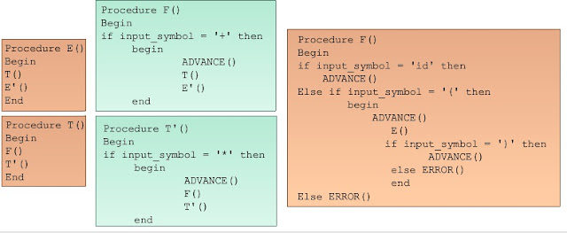

Slide 91
Solution:
Procedure E()
{ T()
E’()
if lookahead = $
declare success
else
Error()
}
Procedure E’()
{ if lookahead = +
{ match(+)
T()
E’()
}
else
NULL
}
Procedure T’()
{ if lookahead = *
{ match(*)
F()
T’()
}
else
NULL
}
Procedure T()
{ F()
T’()
}

Slide 92
Cont…
Procedure F()
{
If lookahead == id
{ match(id) }
Else if lookahead == ‘(‘
{ match(‘(‘)
E()
if lookahead == ‘)’
match(‘)’)
else
Error()
}
Else { Error() }
}
Proceduce Match(token t)
{
If lookahead=t
lookahead=next_token;
Else
Error();
}
Procedure Error
{
Print(“Error”);
}

